Slide 1
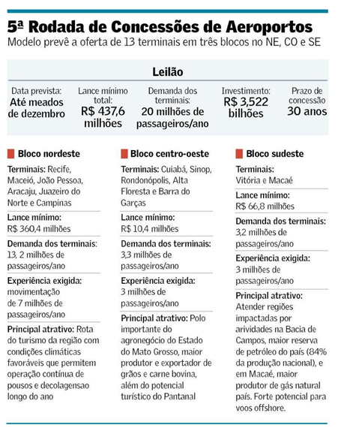
Valor online – 14/06/18

